Slide 1
Multilevel Politics
“All politics is local” (Thomas (‘Tip) O’ Neill JR)

Slide 2
What is Geopolitics?
Geopolitics is an approach to foreign policy analysis that understands actions, relationships and significance of states in terms of geographical factors.
Geographical factors: location, climate, physical terrain, and population.
The advance of globalization is sometimes seen to have made geopolitics obsolete.

Slide 3
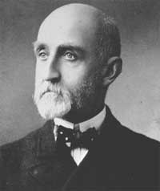
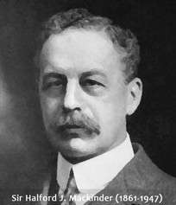
Authors exposed to Geopolitics
Who argued that the state that controls the seas would control world politics
Halford Mackinder (1861-1947)
Who suggested that control of the land mass between Germany and central Siberia is the key to controlling world politics.
Alfred Mahan (1840-1914)

Slide 4
Multilevel Governance
Emerges when experts from several tiers of government share the task of making regulations and forming policy.
Wider range of actors involved not only local or regional governments but also interest groups more point of access and influence for private groups.
Vertical cooperation rather than horizontal for a policy area
Political representatives more power and authority, but interest group experts more knowledge and ability to judge about problem.
Communication still operates in a constitutional framework for limits and opportunities.

Slide 5
Federalism
Is the principle of sharing sovereignty between central and state (or provincial) governments.
A form of multilevel governance with a constitutional device.
For examples: -diverse religion in Lebanon.
-US
- Germany (doc)

Slide 6
Federation
Is any political system that puts this idea into practice.
Divides the tasks among the states and is in charge of external relations.
The states are represented in government as an upper assembly.
Some federations are less balanced: some states are given more autonomy than others: Risk of instability.

Slide 7
How to form a federation?
Two ways:-Creating a new central threat.
-Transferring sovereignty from an existing government to lower levels.

Slide 8
Confederation
Is a looser link between participating countries, with the members retaining their separate statehood.
More than a alliance less than a federation
Example of US: weak centre with a lack of direct authority.

Slide 9
Dual and cooperative federalism
Nation and state governments operate independently with each tier acting autonomously in its own sphere and linked only through the constitutional compact.
Coordination not necessary or not feasible(=opposite of multilevel governance)
Example: US
Collaboration between levels: national and state governments as partners
Solidarity: a share commitment to united society, moral form.
Example: Germany
Dual federalism
Cooperative Federalism

Slide 10
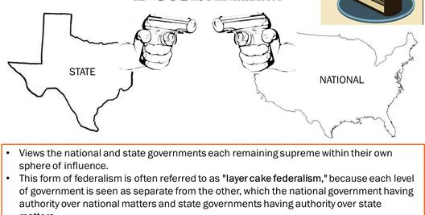
Dual federalism

Slide 11
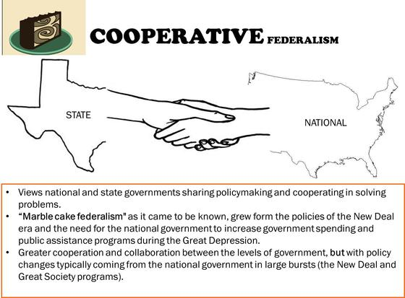
Cooperative federalism

Slide 12
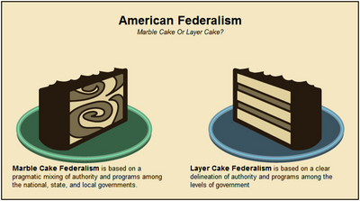

Slide 13
Federalism
Strength | Weakness
A practical arrangement of large countries | May be less effective in responding to security threats (e.g. terrorism)
Provides additional checks and balances | Decision-making is slow and complicated
Reduces overload at the centre | Can entrench divisions between provinces
Provides competition between provinces and allows citizens to move between them. | The centre experiences greater difficulty in launching national initiatives.
Offers opportunities for policy experiments | How citizens are treated depend on where they live
Allows small units to cooperate in achieving the economic and military advantages of size. | -Unclear accountability to the public -May permit majorities within a province to exploit minority
Brings government closer to the people | Basing representation on provinces violates the principle of one person, one vote.

Slide 14
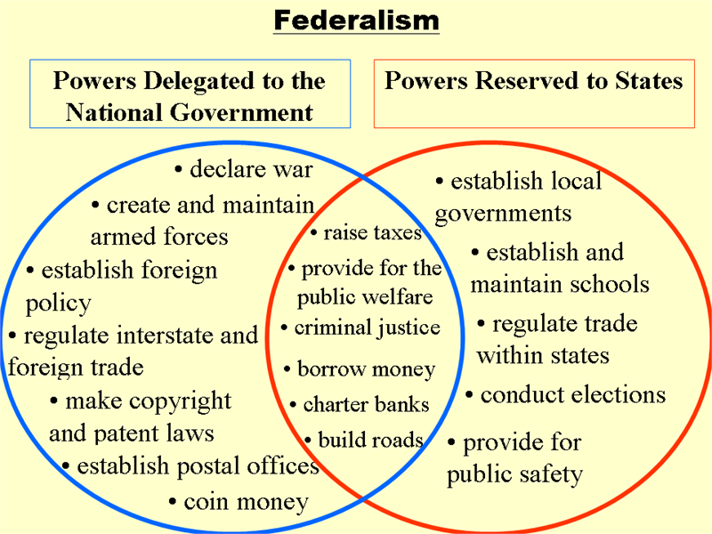

Slide 15
Unitary States
Sovereignty lies exclusively with the central government
The central government can give subnational administrative.
National legislature has mostly only one chamber: second chamber for representing the provinces not needed
Common in smaller democracies without strong ethnic divisions.
Three abroad ways in which a unitary state can disperse power from the centre:

Slide 16
cont
Deconcentration: spreads the works, movement of central government employees away from the capital.
Decentralization: central government functions are executed by subnational authorities
Devolution: centre grants decision-making autonomy to lower levels.

Slide 17
VIDEO click to Unity
German Unity Day: the Future of Federalism

Slide 18
